Slide 1
Saturday Race Meets
Prior to the Event
On the Day
After the Event

Slide 2
Prior to the Event
Our Race Committee plans the summer season into two halves. First half October – December and the second half January – March.
Once finalised the programme of events are submitted to Swimming NSW for approval.
Each week competitors register for the next meet online and prior to 12mn the Wednesday before the event.
There are rules regarding the number of races that can be entered and qualifying times.
The OPERATOR OF AUTOMATIC OFFICIATING EQUIPMENT (AOE) Operator checks entries and creates a Start List. This is distributed to each official, prior to the event.
The agreement with Ku-ring-gai Aquatic centre is that we relinquish 2 lanes at 0915hrs , which are made available to general entry swimmers.
The AOE accommodates this electronically prior to race day.

Slide 3
On the Day (in brief)
An early start for our volunteer officials
The diving blocks are installed, timing equipment checked, sun shade erected for our time keepers and swimmers in the marshalling area etc
Our Chief Time Keeper enrols volunteer timekeepers and checks all watches are operational. Volunteer parents are enrolled to help on the day.
Our Clarke of Course (Chief Marshal).
Identify and assemble swimmers who report for competition.
Identify the names of swimmers who do not report for the event.
Seek permission from the Referee where amalgamations or reseeding may be possible.
Report approval of amalgamations or reseeding to the Control Room Supervisor / Chief Recorder
Ensure only authorised persons access the marshalling area.
Ensure swimmers to report for the event in a timely manner.
Pass swimmers for each heat to the Check Starter.

Slide 4
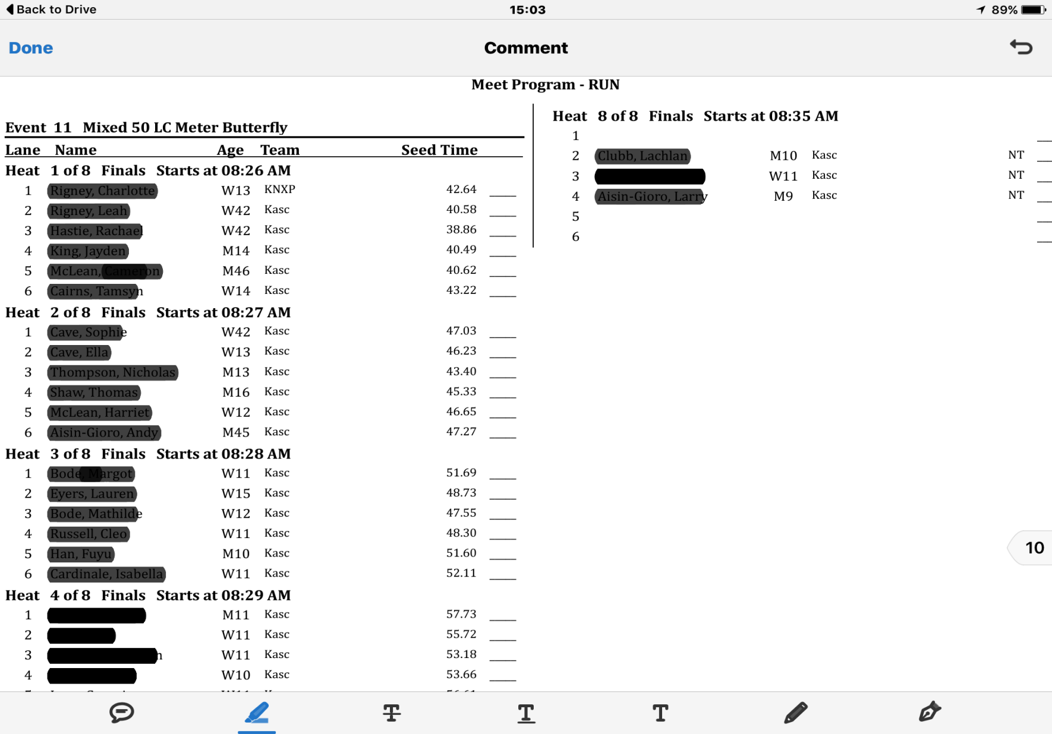
Sample Running Sheet
NS
These are true empty lanes and can be filled at the Marshals discretion
This person did not swim for some reason. Technically this is NOT an empty lane and cannot be filled by another swimmer. Why? Because the time recorded will be allocated to the swimmer who SHOULD have swam.
Notes:
These are true empty lane and can be filled at the Marshals discretion

Slide 5
Check Starter and Starter
Our Check Starter
Ensures that the swimmers for each race are correct by checking name and lane number against the race sheet.
Instruct the swimmers when to move onto the pool deck and direct them to their assigned lanes.
Be aware, and provide assistance to any swimmers where required.
Our Starter
Following the Referees second long whistle commands "Take your marks", swimmers take up a starting position with at least one foot at the front of the starting platforms. When all swimmers are stationary, the Starter shall give the starting signal.
Our (AOE) Operator plays a very important role in ensuring electronic times and places are accurately captured for each swimmer.

Slide 6
Referee
Our Referee also Judge of Stroke
At the commencement of each event, the Referee shall signal to the swimmers by a long whistle indicating that they should take their positions on the starting platform (or for Backstroke swimming and Medley Relays to immediately enter the water).
A second long whistle shall bring the Backstroke and Medley Relay swimmers immediately to the starting position.
The pool is checked throughout and at the end of every race for any possible infractions.
Ensuring that swimmers comply with the relevant rules for each stroke including turns and finishes.
The Referee assumes total responsibility for all disqualifications during the competition.
The aim of KASC is to mentor all our swimmers. Many of our swimmers are new to the rules of competition. Our referee will always provide feedback on infringements when not engaged in a race.

Slide 7
After the Race
All equipment is packed away.
Our AOE checks race results and enters them into Swimming NSW for approval.
checks the point score calculations.
Uploads the race results onto the club website.
What can you do to Support Your Club?
As with all community sport our club relies on Volunteers
By getting involved you not only contribute to our great Community Spirit but you will also understand the sport more.
There are small Official Roles that you can obtain online training and certification.
But after a busy meet what we would really like help with, is packing up.

Slide 8
FYI
All are officials are volunteers and are fully accredited by Swimming NSW.
All have current WWC.
Amalgamations and Reseeding. To facilitate this process swimmers/parents need to notify the Chief Marshall when withdrawing from an event. The process requires changes on Meet Manager (our swimming management software)
This process is time consuming and is not recommended by Swimming NSW for 50m and 100m events.
Swimming NSW has made the process of accreditation very streamline with online training modules. Several of our time keepers have taken the opportunity to become accredited.
Only swimmers who have registered online prior to the meet will be recorded with an official time and awarded points.
If you missed registration and still would like to swim we will endeavour to accommodate where reasonably possible.

